Slide 1

Data analysis with R Bruno Bellisario, Phd
session 4 Statistical inference#2

Slide 2
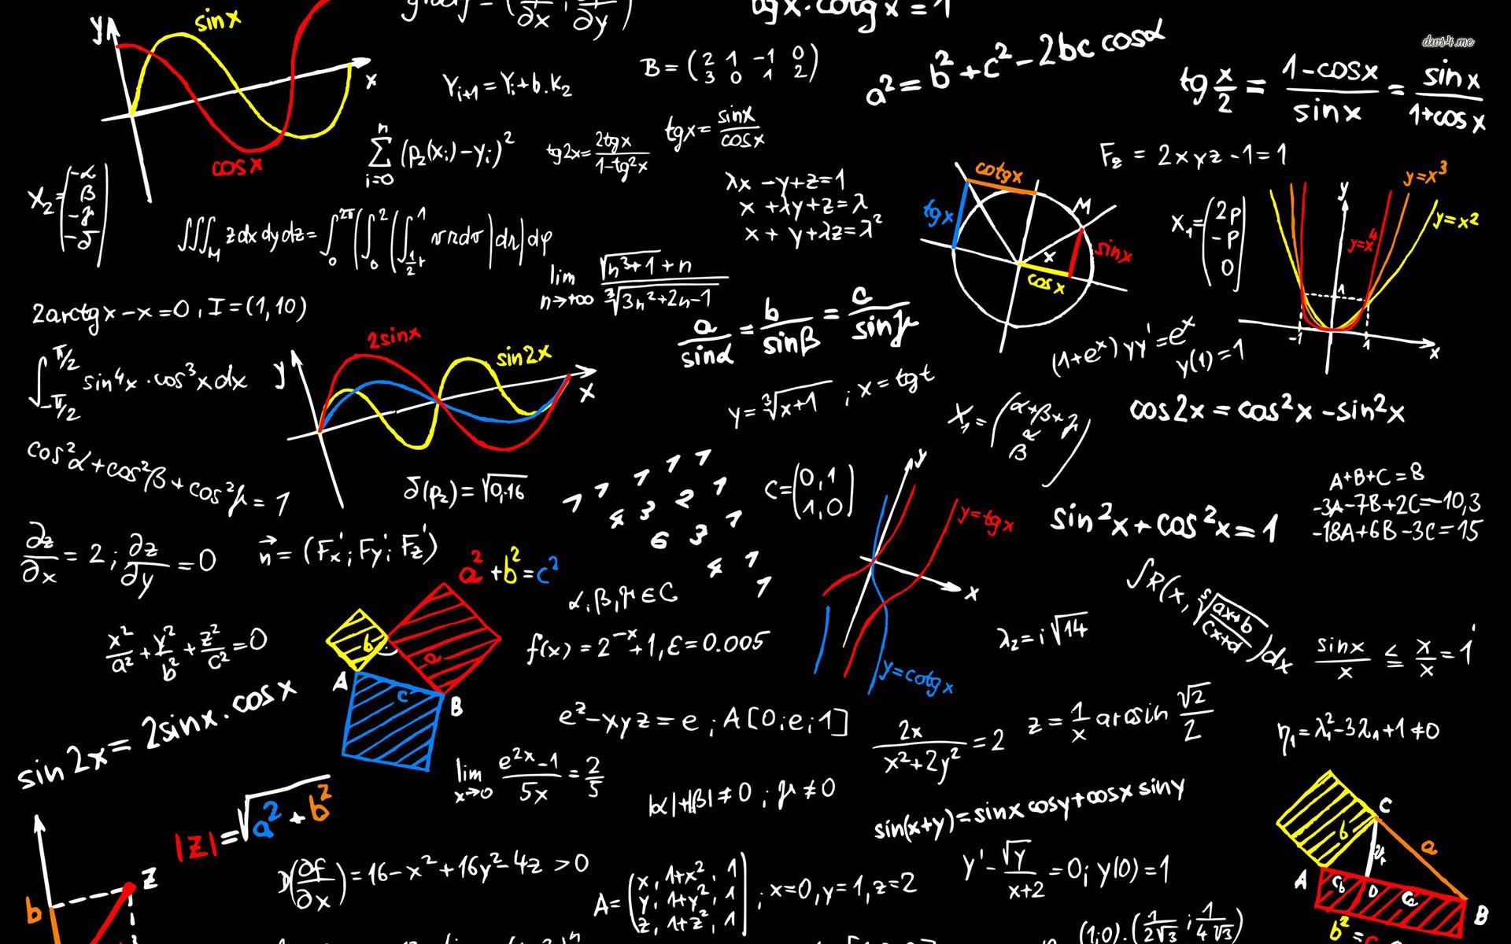
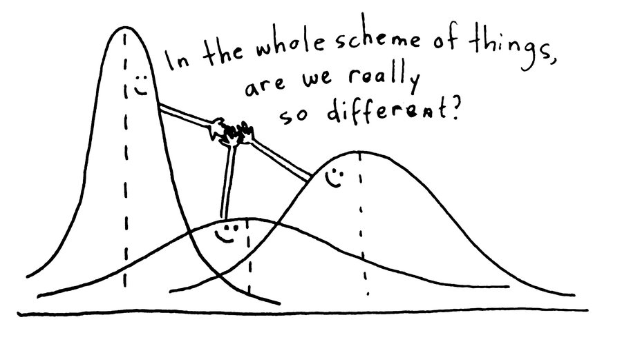
one-way ANOVA

Slide 3
one-way ANOVA
A one-way analysis of variance (ANOVA) is like an independent t-test, except that it can compare more than two groups.
Appropriate data
One-way data. That is, one measurement variable in two or more groups
Dependent variable is interval/ratio, and is continuous
Independent variable is a factor with two or more levels (two or more groups)
Residuals are normally distributed (moderate deviation from normally-distributed residuals is permissible)
Groups have the same variance (homoscedasticity)
Observations among groups are independent.
Hypotheses
Null hypothesis: The means of the measurement variable for each group are equal.
Alternative hypothesis (two-sided): The means of the measurement variable for among groups are not equal.

Slide 4
one-way ANOVA w/blocks
Blocks are used in an analysis of variance or similar models in order to account for suspected variation from factors other than the treatments or main independent variables being investigated.
Traditionally, in agricultural experiments, plots would be arranged into blocks according to factors in the field that could not be controlled.
The experiment might be designed in a randomized complete block design in which each block had a plot with each treatment.

Slide 5
one-way ANOVA w/blocks
Appropriate data
One-way data, with blocks. That is, one measurement variable in two or more groups, where each group is also distributed among at least two blocks
Dependent variable is interval/ratio, and is continuous
Independent variable is a factor with two or more levels.
A second independent variable is a blocking factor variable with two or more levels
Residuals are normally distributed (moderate deviation from normally-distributed residuals is permissible)
Groups have the same variance (homoscedasticity)
Observations among groups are independent.
Hypotheses
Null hypothesis: The means of the measurement variable for each group are equal
Alternative hypothesis (two-sided): The means of the measurement variable for among groups are not equal
An additional null hypothesis is tested for the effect of blocks: The means of the measurement variable for each block are equal

Slide 6
one-way ANOVA w/random blocks
Here, the analysis is done with a mixed effects model, with the treatments treated as a fixed effect and the blocks treated as a random effect.
In analysis of variance, blocking variables are often treated as random variables.
This is because the blocking variable represents a random selection of levels of that variable.
The analyst wants to take the effects of the blocking variable into account, but the identity of the specific levels of the blocks are not of interest.

Slide 7
two-way ANoVA
A two-way anova can investigate the main effects of each of two independent factor variables, as well as the effect of the interaction of these variables.
Appropriate data
Two-way data
Dependent variable is interval/ratio, and is continuous
Independent variables are a factor with two or more levels
Residuals are normally distributed (moderate deviation from normally-distributed residuals is permissible)
Groups have the same variance (homoscedasticity)
Observations among groups are independent
Hypotheses
Null hypothesis 1: The means of the dependent variable for each group in the first independent variable are equal
Alternative hypothesis 1 (two-sided): The means of the dependent variable for each group in the first independent variable are not equal
Similar hypotheses are considered for the other independent variable
Similar hypotheses are considered for the interaction effect

Slide 8
repeated measure ANoVA
When an experimental design takes measurements on the same experimental unit over time, the analysis of the data must take into account the probability that measurements for a given experimental unit will be correlated in some way.
For example, if we were measuring calorie intake for students, we would expect that if one student had a higher intake at Time 1, that that student would have a higher intake others at Time 2, and so on.

Slide 9
correlation & linear regression
Correlation and linear regression each explore the relationship between two quantitative variables.
Correlation determines if one variable varies systematically as another variable changes. It does not specify that one variable is the dependent variable and the other is the independent variable.
The three forms of correlation presented here are Pearson, Kendall, and Spearman. The test determining the p-value for Pearson correlation is a parametric test that assumes that data are bivariate normal. Kendall and Spearman correlation use nonparametric tests.

Slide 10
correlation & linear regression
Linear regression specifies one variable as the independent variable and another as the dependent variable. The resultant model relates the variables with a linear relationship.
The tests associated with linear regression are parametric and assume normality, homoscedasticity, and independence of residuals, as well as a linear relationship between the two variables.

Slide 11
correlation & linear regression
There are different methods to perform correlation analysis:
Pearson correlation (r), which measures a linear dependence between two variables (x and y). It’s also known as a parametric correlation test because it depends to the distribution of the data. It can be used only when x and y are from normal distribution.
The plot of y = f(x) is named the linear regression curve.
Kendall tau and Spearman rho, which are rank-based correlation coefficients (non-parametric).

Slide 12
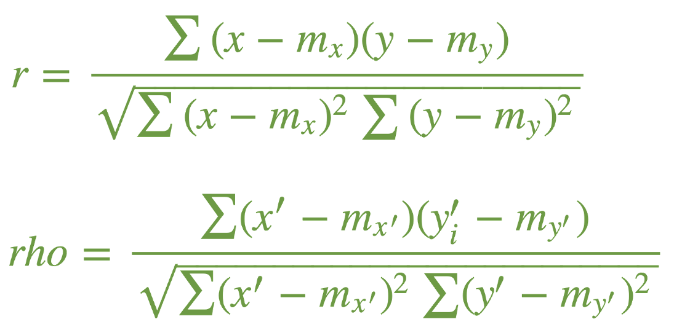
correlation & linear regression
In the formulas below, x and y are two vectors of length n mx and my corresponds to the means of x and y, respectively.

Slide 13
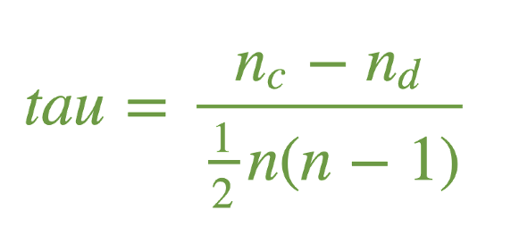
correlation & linear regression
The Kendall correlation method measures the correspondence between the ranking of x and y variables. The total number of possible pairings of x with y observations is n(n−1)/2, where n is the size of x and y.
In the formula below, nc is total number of concordant pairs nd is total number of discordant pairs n is the size of x and y

Slide 14
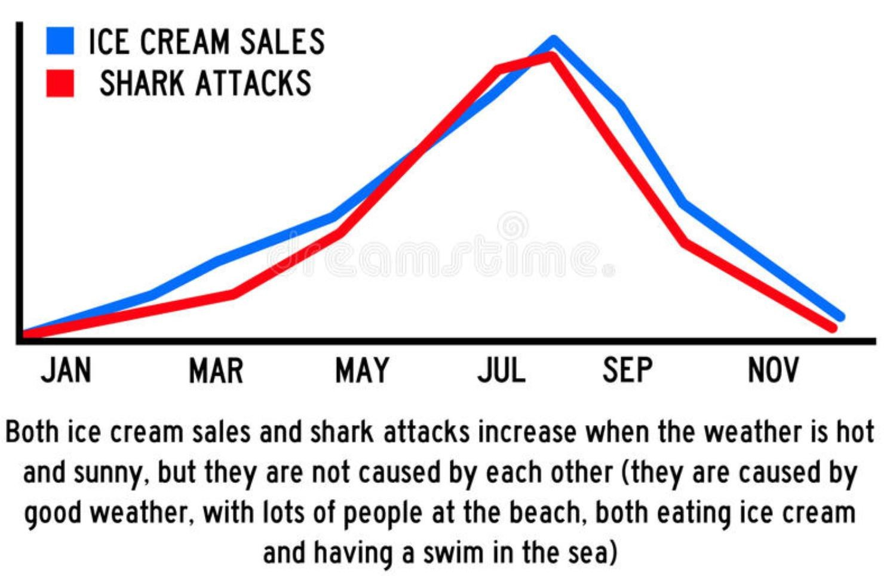
correlation & linear regression
Beware of spurious correlations!
In statistics, a spurious relationship or spurious correlation is a mathematical relationship in which two or more events or variables are associated but not causally related, due to either coincidence or the presence of a certain third, unseen factor (referred to as a "common response variable", "confounding factor", or "lurking variable").

Slide 15
correlation & linear regression
Linear regression is a very common approach to model the relationship between two interval/ratio variables.
The method assumes that there is a linear relationship between the dependent variable and the independent variable, and finds a best fit model for this relationship.
The outcome of linear regression includes estimating the intercept and the slope of the linear model.
Linear regression can then be used as a predictive model, whereby the model can be used to predict a y value for any given x. In practice, the model shouldn’t be used to predict values beyond the range of the x values used to develop the model.

Slide 16
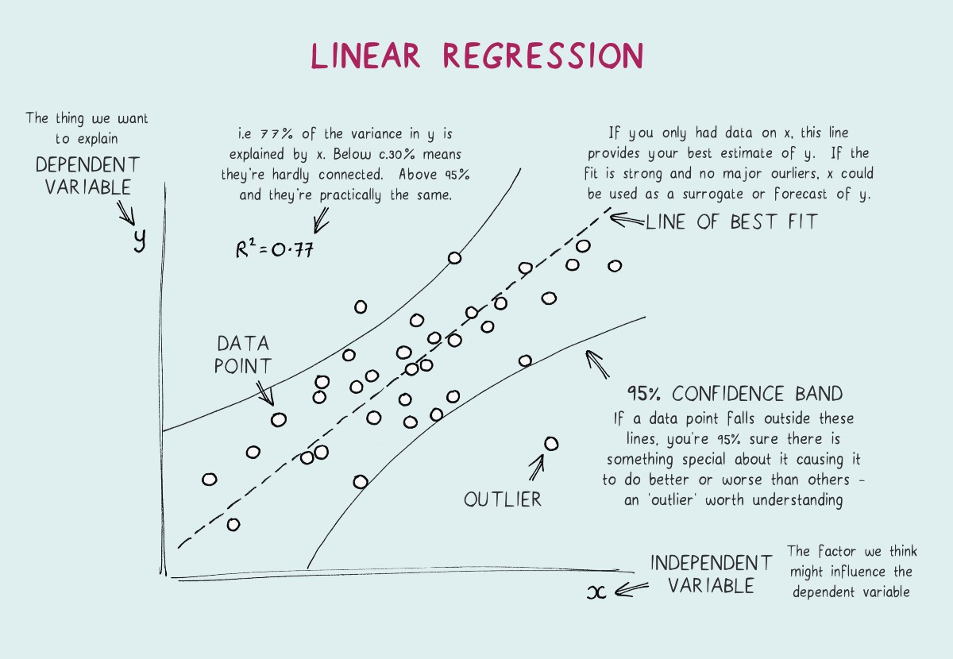
correlation & linear regression

Slide 17
correlation & linear regression
Mathematically, a regression line assumes the form of y = ax + b, with a the intercept (the location where it intersects an axis) and b the slope (the steepness of a line).
Both can be used to estimate an average rate of change. The greater the magnitude of the slope, the steeper the line and the greater the rate of change.

Slide 18

correlation & linear regression
If the independent variable were of nominal type, then the linear regression would become a one-way analysis of variance!!
Indeed, in R, the same syntax can be used to perform both ANOVA and linear regression!

Slide 19
Assessing model assumptions: formal tests to assess normality of residuals
There are formal tests to assess the normality of residuals.
Common tests include Shapiro-Wilk, Anderson–Darling, Kolmogorov–Smirnov, and D’Agostino–Pearson.
Their results are dependent on sample size.
When the sample size is large, the tests may indicate a statistically significant departure from normality, even if that departure is small.
When sample sizes are small, they won’t detect departures from normality!!

Slide 20
Assessing model assumptions: formal tests to assess normality of residuals
Skewness and kurtosis
There are no definitive guidelines as to what range of skew or kurtosis are acceptable for considering residuals to be normally distributed.
If we were forced to give advice for skewness calculations, be cautious if the absolute value is > 0.5, and consider it not normally distributed if the absolute value is > 1.0.
Some authors use 2.0 as a cut-off for normality, and others use a higher limit for kurtosis.

Slide 21
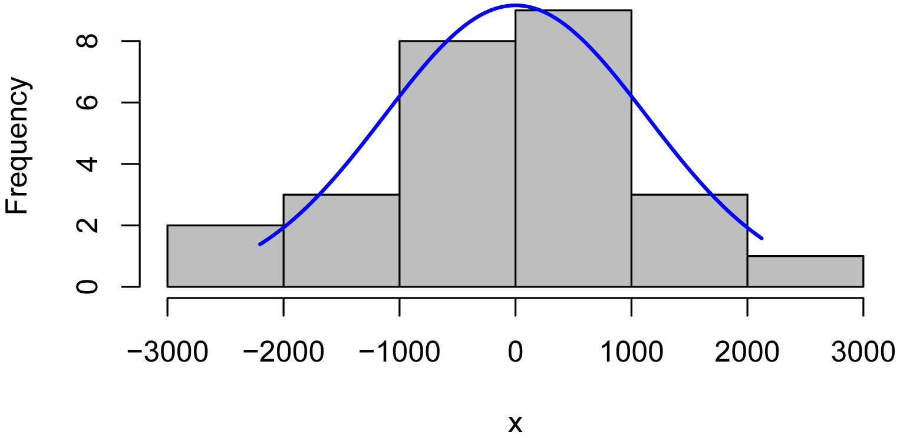
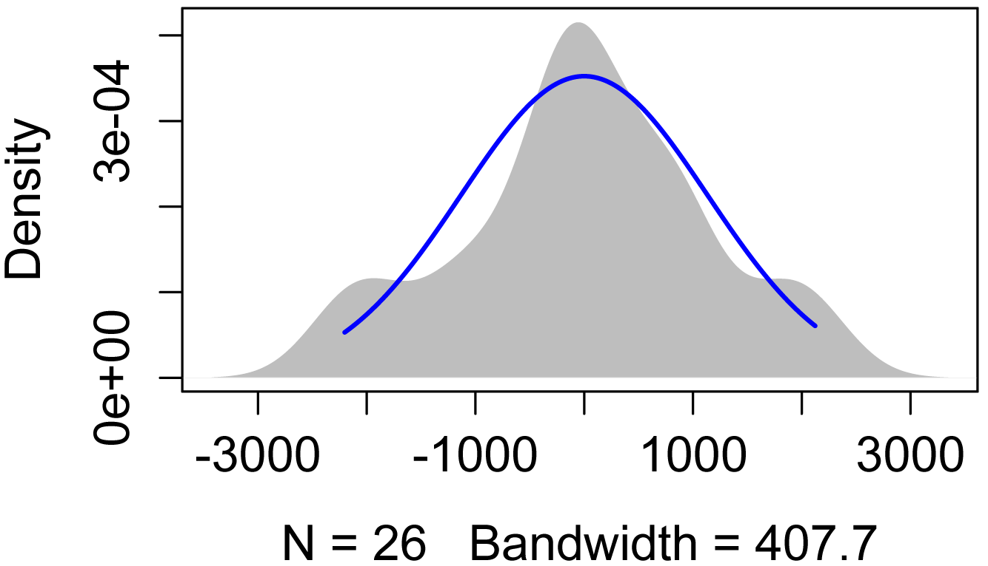
Assessing model assumptions: formal tests to assess normality of residuals
Usually, the best method to see if model residuals meet the assumptions of normal distribution and homoscedasticity are to plot them and inspect the plots visually.

Slide 22
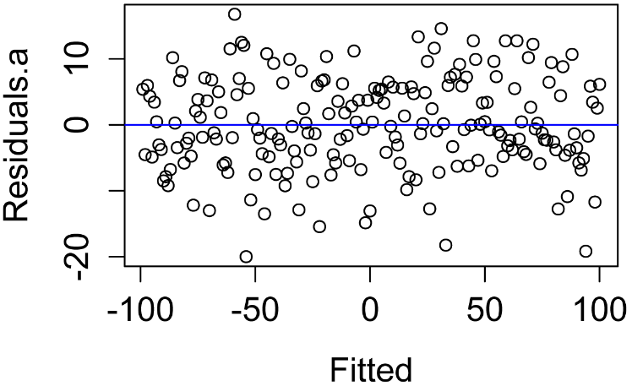
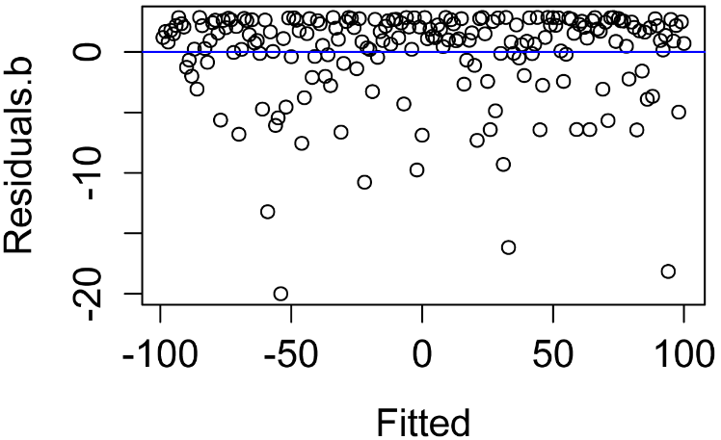
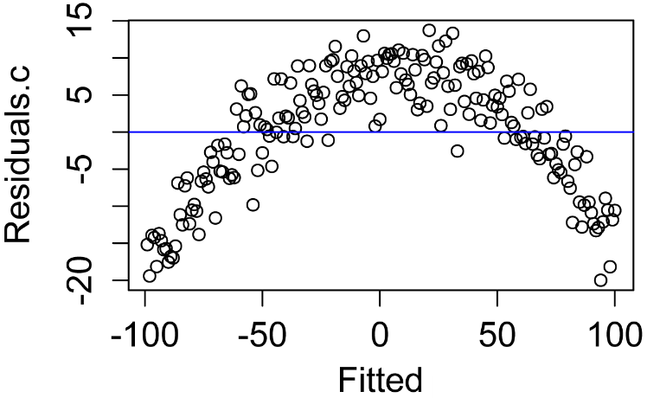
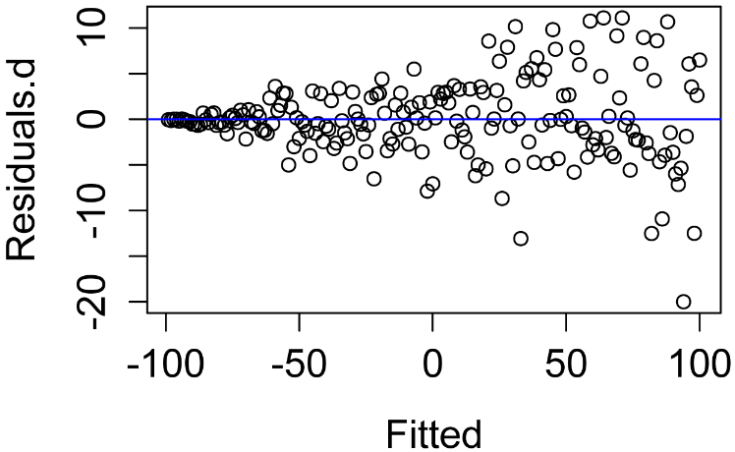
Assessing model assumptions: formal tests to assess normality of residuals
Patterns in the plot of residuals versus fitted values can indicate a lack of homoscedasticity or that errors are not independent of fitted values.
Normally distributed and homoscedastic
Non-normal distribution of residuals
Not independent of the fitted values
Heteroscedasticity

